Slide 1
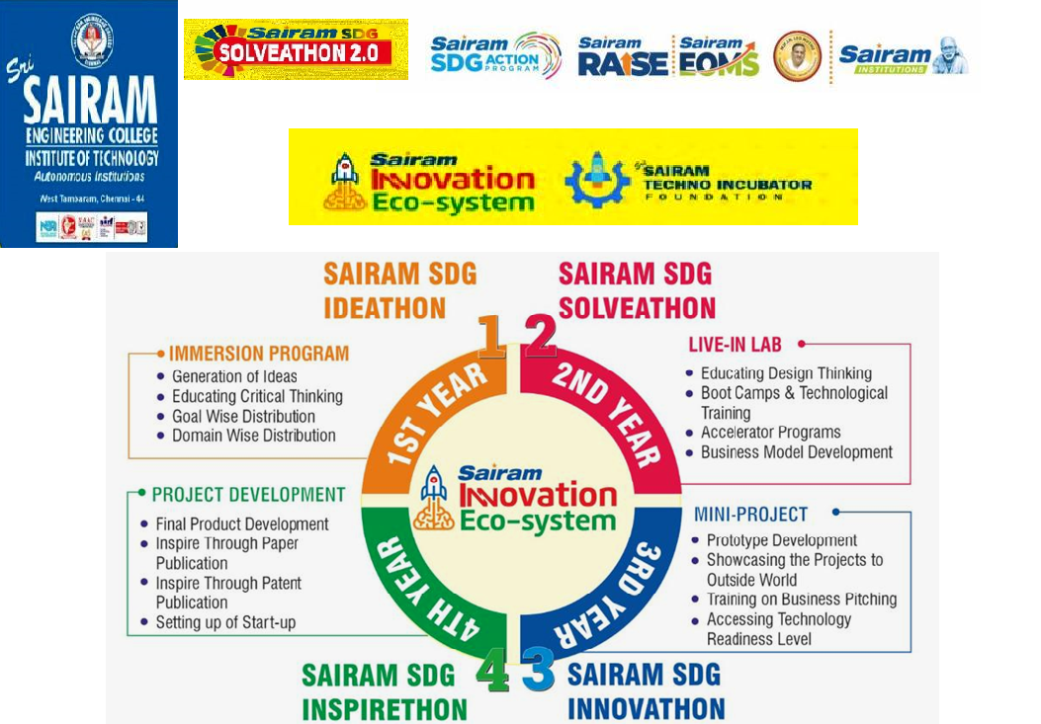

Slide 2
PROJECT TITLE
Primary Goal No : 4 – QUALITY
EDUACTION
Secondary Goal No :10 – REDUCED
INEQUALITIES
Tertiary Goal No : 3 – GOOD HEALTH
AND
WELL - BEING

Slide 3
PROBLEM STATEMENT
Quality education is necessary for all the individuals to develop and advance in the knowledge driven world. Most of the current educational curriculum is oriented towards the use of eyesight, hence, individuals, who are visually impaired experience challenges when acquiring education. The challenges experienced by visually impaired can be resolved by the use of technologies, materials, devices and equipment.
The availability of human assistance in making them understand the concepts and taking exams is vitalIt’s very difficult to train such children, as they are VIP they cannot make differences between the objects ,find the colors or feel something.
Although the technology is being evolving day - by - day they are not able to find a proper solution for the VIP. These children always need a support or someone who they always they depend on. They themselves can’t live their own independent life as other’s lives.

Slide 4
OBEJECTIVE of the idea proposed

Slide 5
LITERATURE REVIEW
S.NO | Title | Authors | Year | Problems Defined | Draw back

Slide 6
EXISTING SYSTEM
Braille is a system of raised dots that can be read with the fingers by people who are blind or who have low vision. Teachers, parents, and others who are not visually impaired ordinarily read Braille with their eyes. Braille is not a language.
Braille is a system of raised dots that can be read with the fingers by people who are blind or who have low vision. Teachers, parents, and others who are not visually impaired ordinarily read Braille with their eyes. Braille is not a language.
Most blind and visually impaired students now attend their neighborhood schools, often aided in their educational pursuits by regular teachers of academics and by a team of professionals who train them in alternative skills.
Braille can be more difficult to learn. Developing the ability to distinguish Braille via touch can take a very long time for a person to learn. Braille literacy is less than 1% in India
Availability of books in braille is also a major issue.

Slide 7
Proposed solution for the problem
The proposed system is an education software using AI and MI that will automatically provide day-to-day learning concepts for the students .
These concepts displayed over the screen are captured by the camera, they are image processed by OCR(Optical Character Recognition).
Text is then converted to voice , person receives it using the Bluetooth that is connected to the spectacles. Audio and voice activation are so commonplace these days that it's more integrative for the user .
The software also analyses the user response via audio feedback, facial gestures, and proceeds based on the user understandability.

Slide 8
Justification for SDG and sap No
SDG Goal :Quality Education
SAP Indicator: 4.a Build and upgrade education facilities that are child, disability and gender sensitive and provide safe, non-violent, inclusive and effective learning environments for all
SAP number – SAP040A01

Slide 9
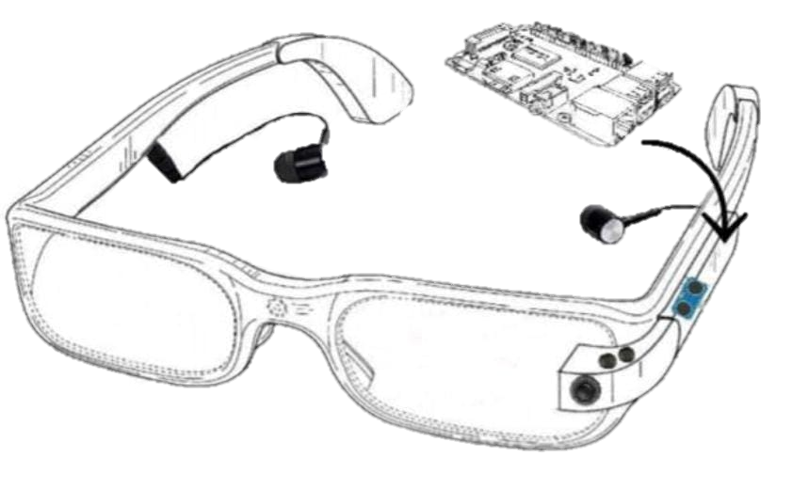
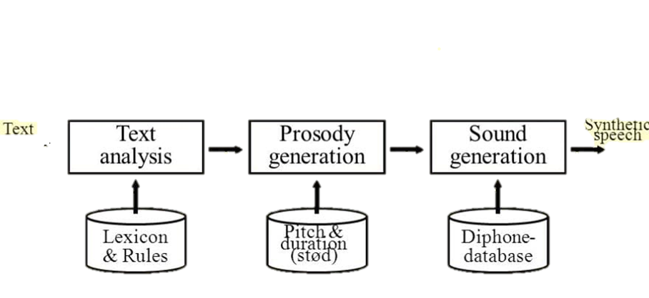

SYSTEM ARCHITECTURE
BASIC STRUCTURE OF PROJECT

Slide 10
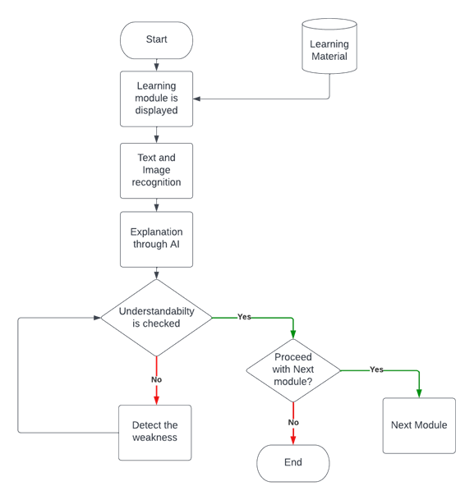
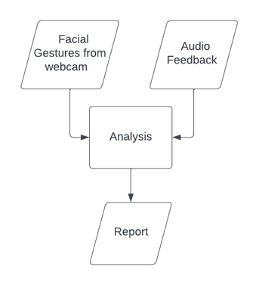


SYSTEM ARCHITECTURE

Slide 11
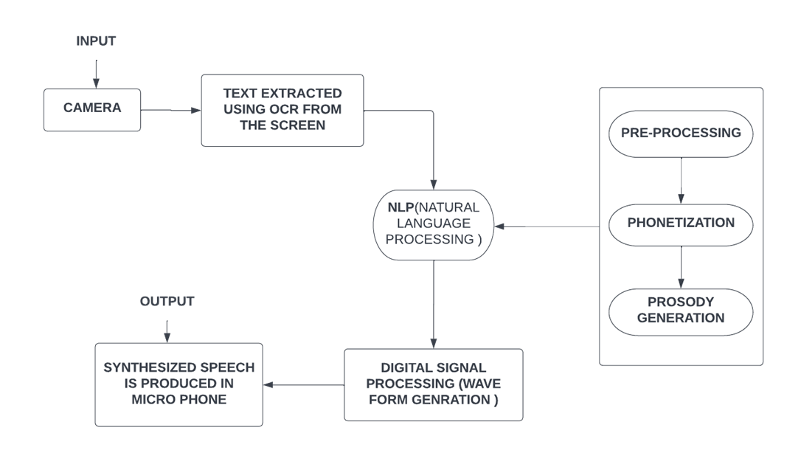

SYSTEM ARCHITECTURE

Slide 12
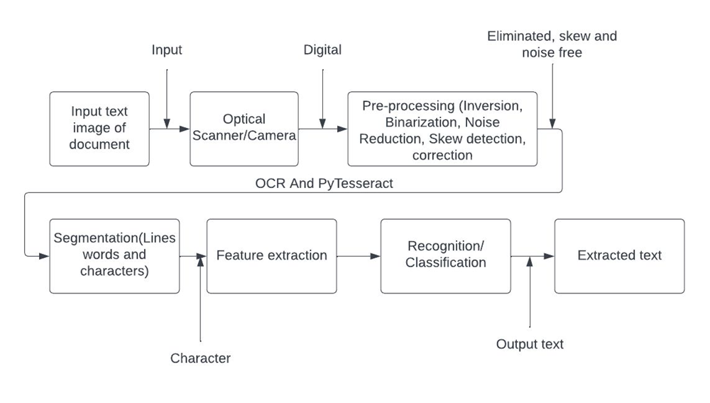
SYSTEM ARCHITECTURE

Slide 13
FUTURE ENHANCEMENT
Methods to teach and learn mathematical problems and learning 3D objects is possible by using the haptic devices can be integrated with this system.
This project can be used in the future as a real-time environment for all VIPs, to help them grasp what is going on in their surroundings and to react and feel things around them. They can live their lives without relying on anyone. The additional camera that has to be added can catch a wider angle of 270 degrees around them and, in the future, if network speed increases, the possibility of any accidents or other issues can be resolved.

Slide 14
CONCLUSION
In this report, the idea of “Smart Voice-Assisted Goggles” is proposed to aid the education of VIPs. The proposed solution is at development stage, where at this stage the project was decided and approved. A simple text extraction module is added which extracts the text from the image shown in-front of the camera, it is made using PyTesseract - OCR and OpenCV. Later a model will be made which will provide accurate results for complex data.

Slide 15
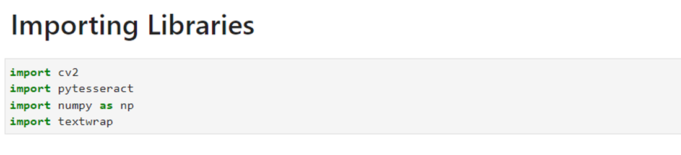
RESULT
These are the libraries required for the below program, which is for image real time image extraction.
The below code is for the image extraction, which is done through the webcam . In the captured video, every frame is extracted as an image and pre-processed using openCV after which pytesseract function ‘image_to_string()’ converts text in image to python string. Which is later stored in a text file.
The borders around the text drawn and text is wrapped within the window using textwrap module.
The window exists until the user press ‘q’ in the keyboard to exit.

Slide 16
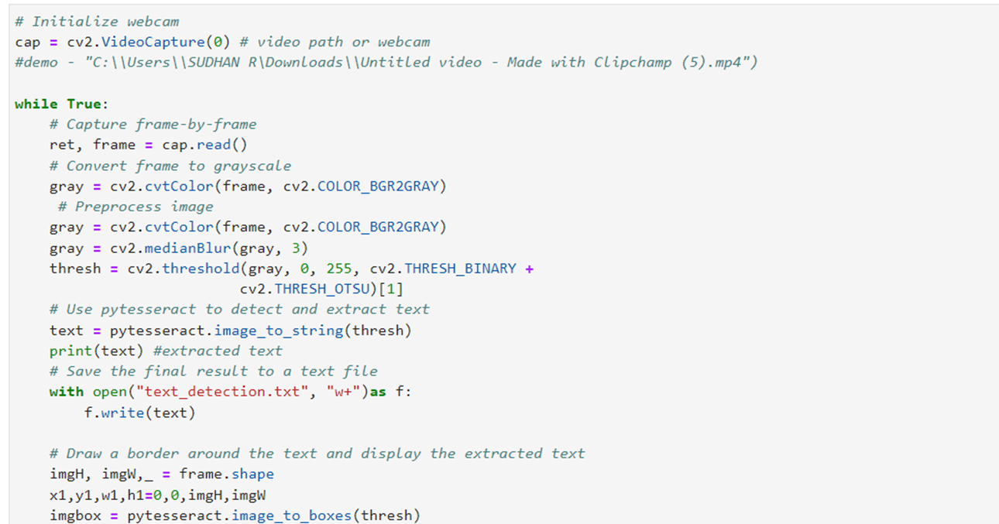
Continuation..

Slide 17
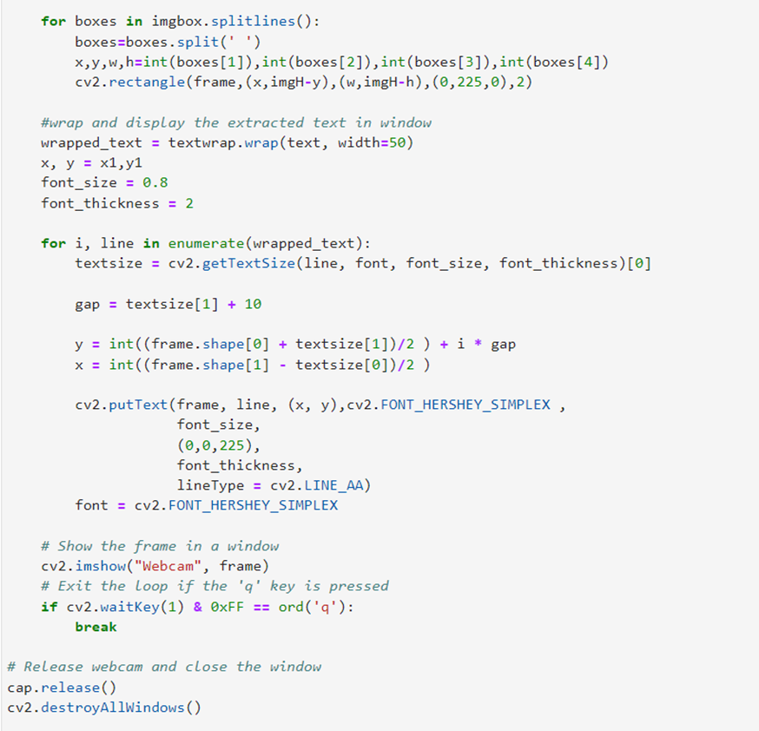
Continuation..

Slide 18
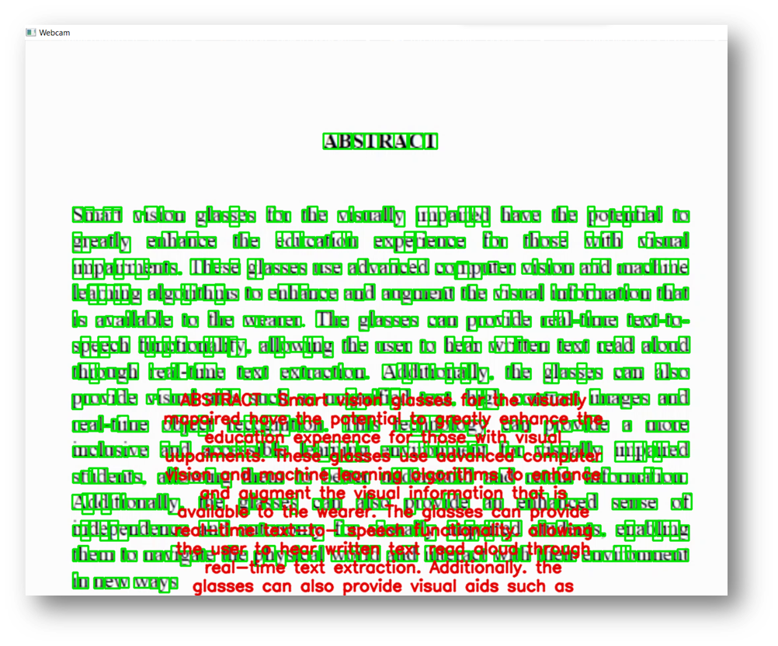
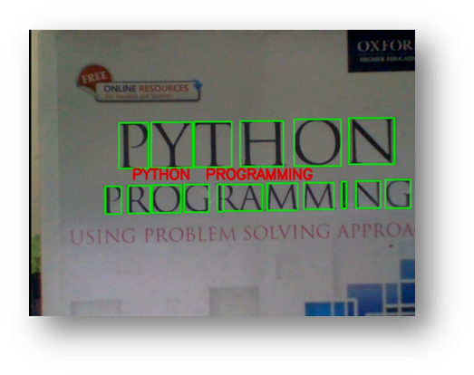
OUTPUT

Slide 19
OUTPUT

Slide 20
REFERENCE
[1] Shanthi K G* , 2.Jaisree S M, 3.Mallavaram Gowri Priya Reddy, 4.Maalavi A S, 5.Lakshmipraba P, ‘‘Smart Vision using Machine learning for Blind ,’’ IEEE TRANSACTIONS ON NEURAL SYSTEMS AND REHABILITATION ENGINEERING, VOL. 29, 2021.
[2] Dapeng Chen , Member, IEEE, Jia Liu, Member, IEEE, Lei Tian, Xuhui Hu , and Aiguo Song , Senior Member, IEEE,‘‘Research on the Method of Displaying the Contour Features of Image to the Visually Impaired on the Touch Screen,’’ IEEE TRANSACTIONS ON NEURAL SYSTEMS AND REHABILITATION ENGINEERING, VOL. 29, 2021
[3] Raquel Espinosa-Castañeda, Hugo I. Medellín-Castillo, ‘‘Virtual haptic perception as an educational assistive technology: a case study in inclusive education,’’ TH‐2020‐01‐0009, IEEE Xplore.
[4]. PAÚL MEJÍA 1,2, (Member, IEEE), LUIZ CÉSAR MARTINI 1,FELIPE GRIJALVA 3 , (Senior Member, IEEE), AND ANA MARÍA ZAMBRANO 4 ,‘‘CASVI: Computer Algebra System Aimed at Visually Impaired People. Experiments,’’ TH‐2020‐01‐0009, IEEE Explore.

Slide 21
REFERENCE
[5]. Wan-Jung Chang , Member, IEEE, Liang-Bi Chen , Senior Member, IEEE, Cheng-You Sie , and Ching-Hsiang Yang,‘‘An Artificial Intelligence Edge Computing-Based Assistive System for Visually Impaired Pedestrian Safety at Zebra Crossings,’’ IEEE TRANSACTIONS ON CONSUMER ELECTRONICS, VOL. 67, NO. 1, FEBRUARY 2021.
[6] Soumya Kuruvayil, Suja Palaniswamy, “Emotion recognition from facial images with simultaneous occlusion, Journal of King Saud University – Computer and Information Sciences 34 (2022) 7271–7282, ScienceDirect.
[7] Md. Wahidur Rahman , Saima Siddique Tashfia , Rahabul Islam ,Md. Mahmodul Hasan , Sadee Ibn Sultan , Shisir Mia , Mohammad Motiur Rahman , “The architectural design of smart blind assistant using IoT with deep learning paradigm, Internet of Things (2020)”, doi: https://doi.org/10.1016/j.iot.2020.100344.

Slide 22
REFERENCE
[8] Dapeng Chen , Member, IEEE, Jia Liu, Member, IEEE, Lei Tian, Xuhui Hu , and Aiguo Song , Senior Member, IEEE, “Research on the Method of Displaying the Contour Features of Image to the Visually Impaired on the Touch Screen”, IEEE TRANSACTIONS ON NEURAL SYSTEMS AND REHABILITATION ENGINEERING, VOL. 29, 2021.
[9] PAÚL MEJÍA 1, (Member, IEEE), LUIZ CÉSAR MARTINI 1, FELIPE GRIJALVA 2, (Member,
IEEE), JULIO CÉSAR LARCO 1,3, (Member, IEEE), AND JUAN CARLOS RODRÍGUEZ 4, (Member, IEEE), “A Survey on Mathematical Software Tools for Visually Impaired Persons: A Practical Perspective”, Digital Object Identifier 10.1109/ACCESS.2021.3076306

Slide 23
THANK YOU

